Slide 1

CAR RENTAL MANAGEMENT SYSTEM
Bostan Alexia-Adriana

Slide 2
Technologies Used
Front end:
Angular 19 (Type Script)
Angular Material Design
HTML 5
CSS 3
Back end:
Java
Hibernate
Spring boot
Lombok
MySql database

Slide 3
PROJECT DESCRIPTION
CRUD
Create, Read, Update, Delete
The project was designed for small and medium business that would require managing libraries or similar activities with cross platform access. This also includes storing media in databases as blob’s and passing high volumes of information through http traffic as pages. Clients can also create users based on roles which are secured.
Manages :
• Cars – CRUD operations; • Rentals – CRUD operations; • Customers – CRUD operations;

Slide 4
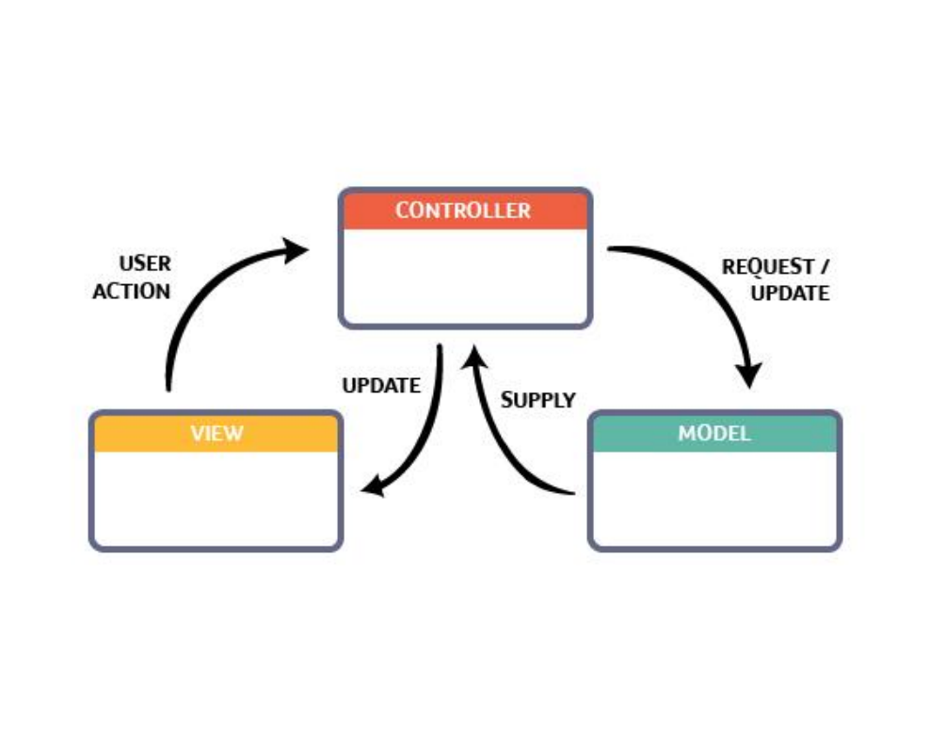
Project Architecture
• Model view controller:
• This is an architectural pattern that separates an application into three main logical components:
Model, View, Controller.
• The MVC model or "pattern" is commonly used for developing modern user interfaces:
• A model is data used by a program. This may be
a database, file, or a simple object, such as an icon or a character in a video game.
• A view is the means of displaying objects within an application. Examples include displaying a window or buttons or text within a window. It includes anything that the user can see.
• A controller updates both models and views. It accepts input and performs the corresponding update.

Slide 5
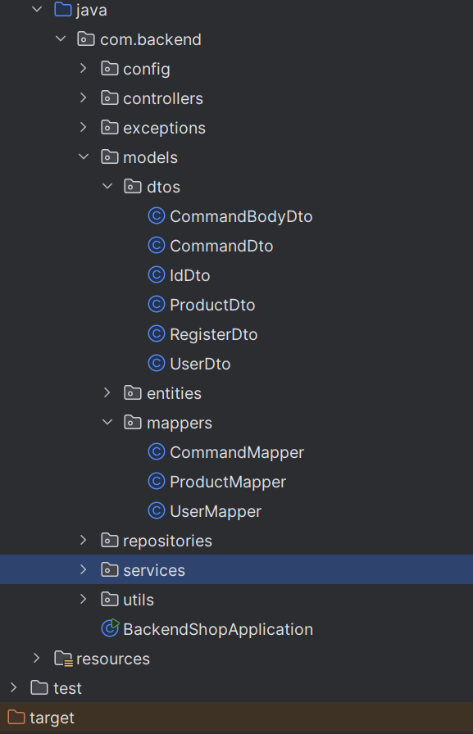
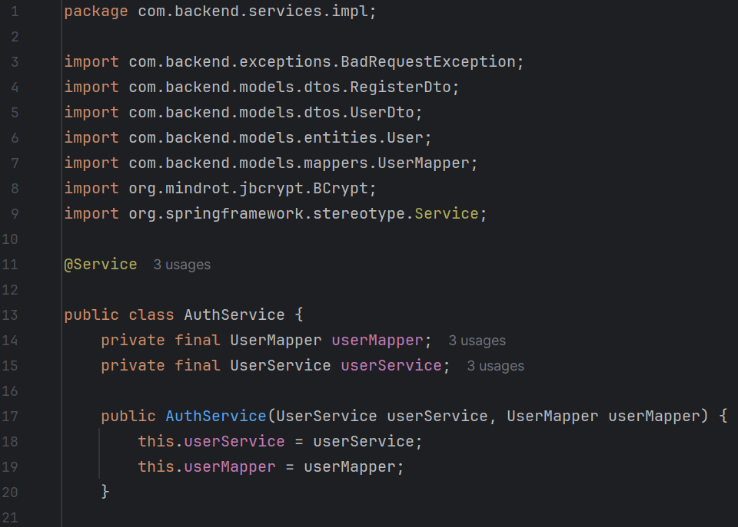
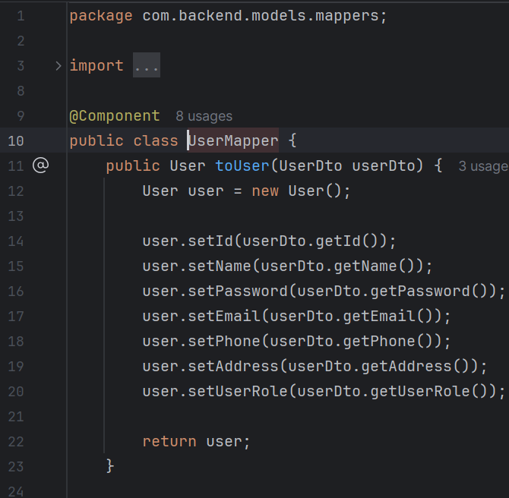
Back end: Java Folder structure: DTO and Mapper

Slide 6
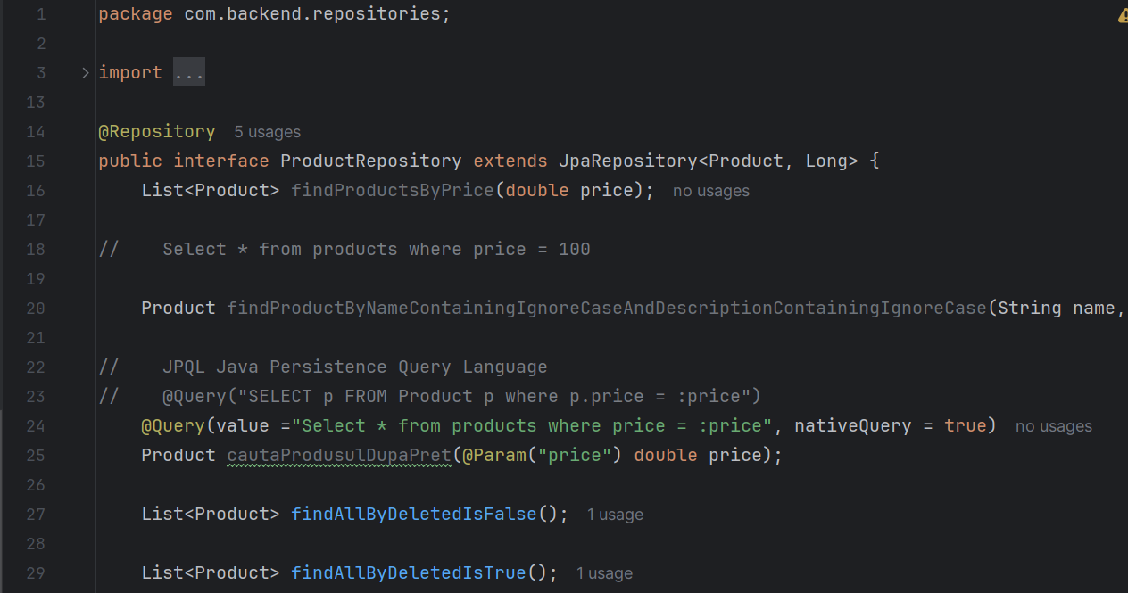
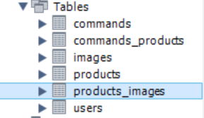
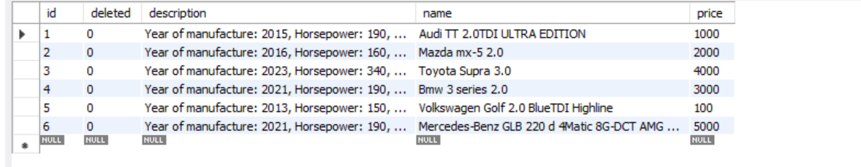
Back end: Java, Hibernate Token configuration with custom query MySQL Database: List of tables Table of Products

Slide 7
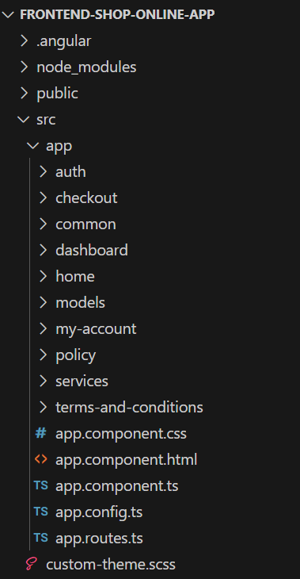
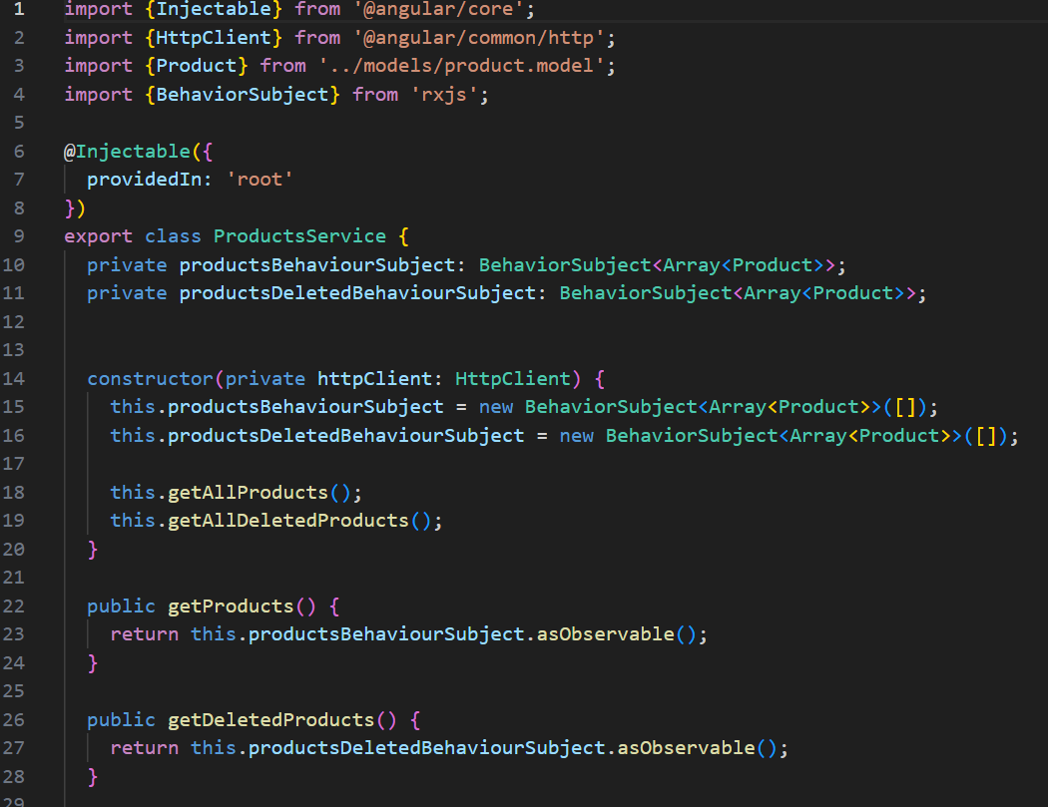
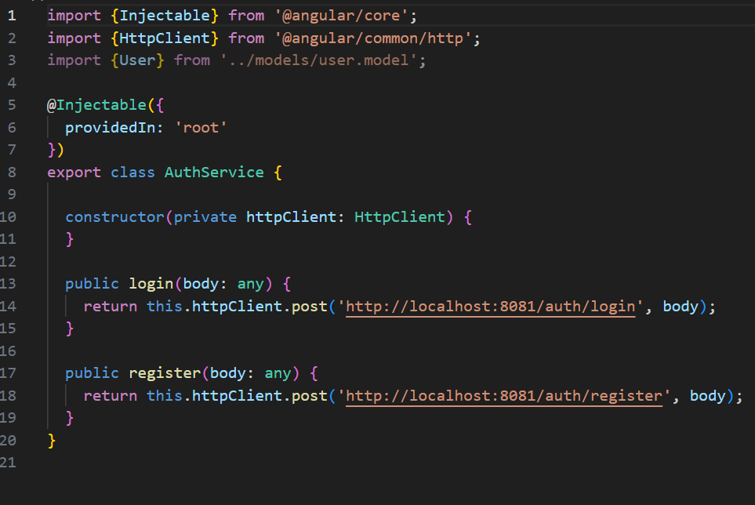
Front end: Angular Folder structure Angular Service class example

Slide 8
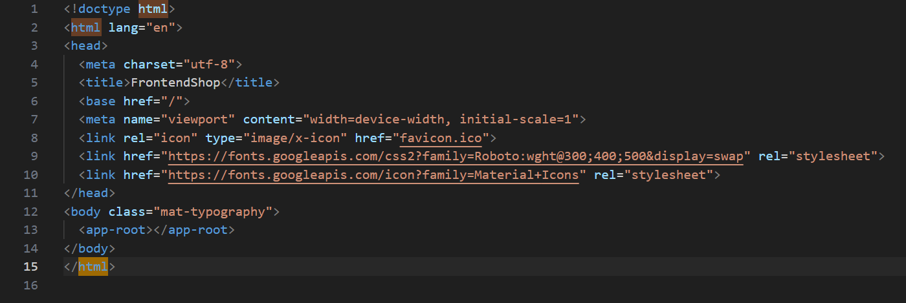
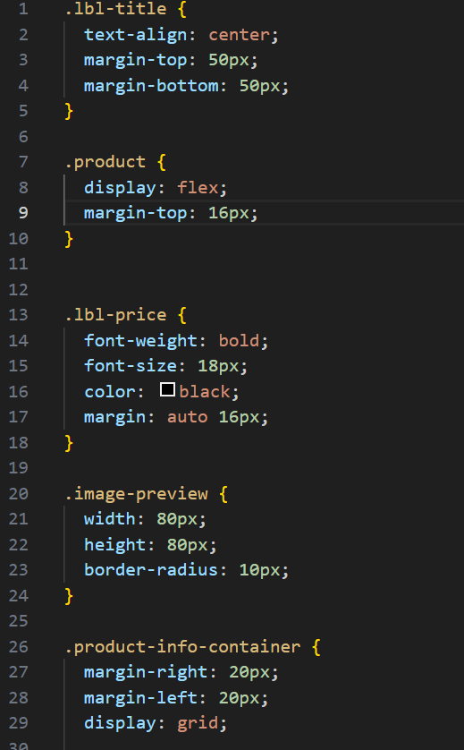
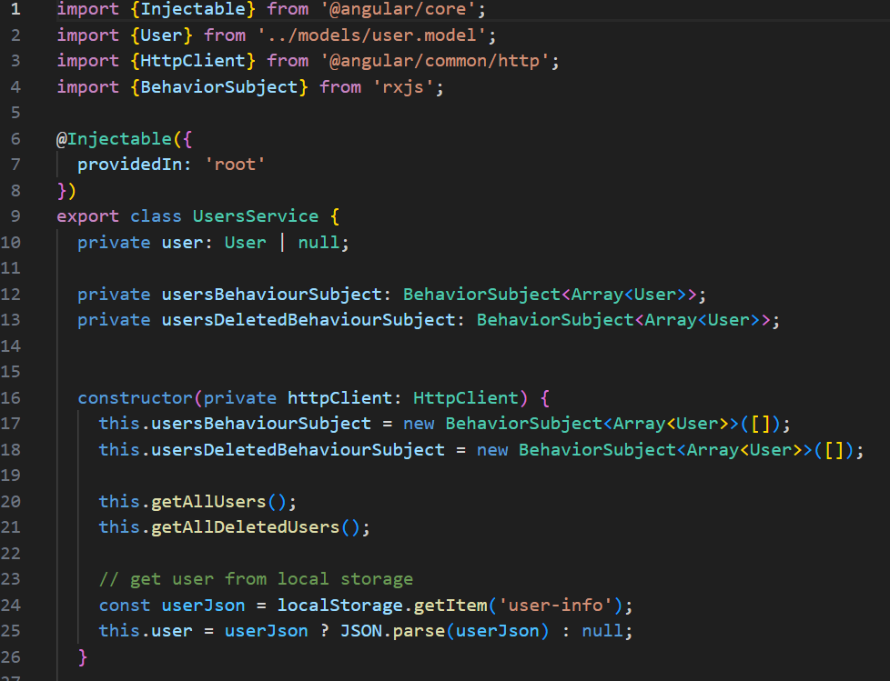
Front end: Angular Typescript class example HTML modal example CSS modal visual alignment

Slide 9
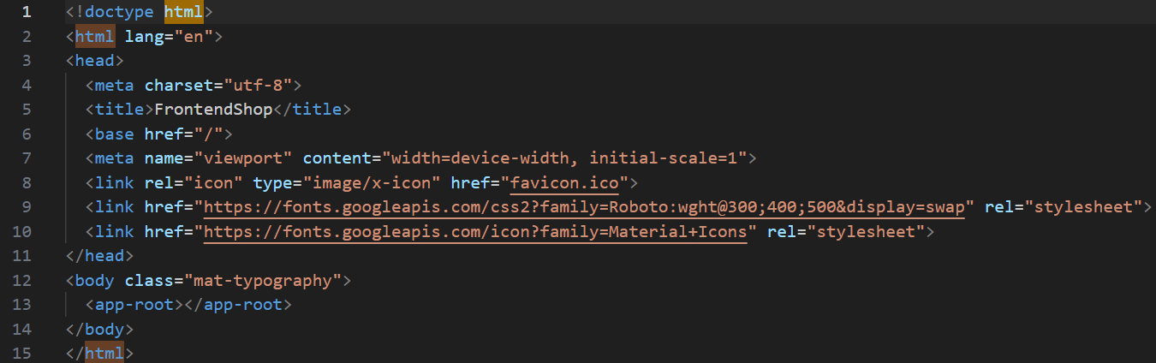
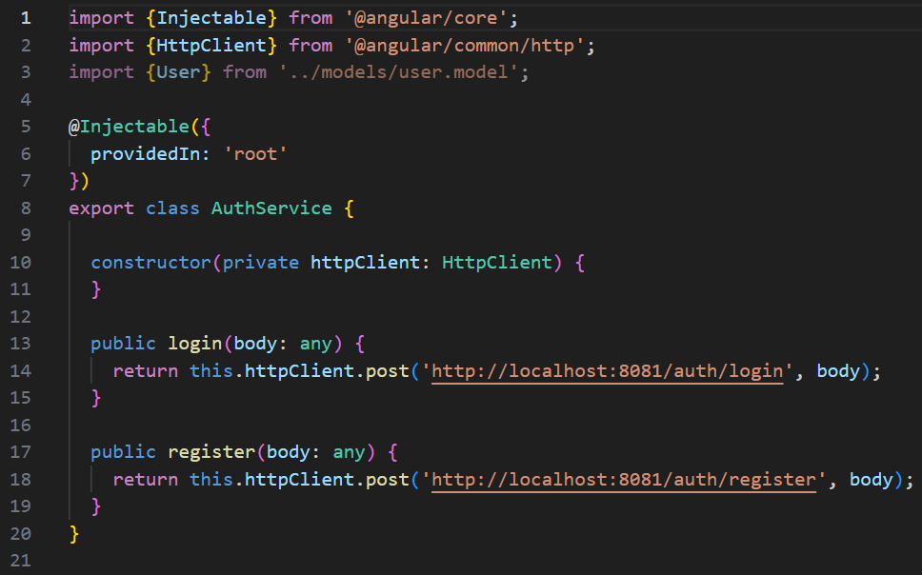
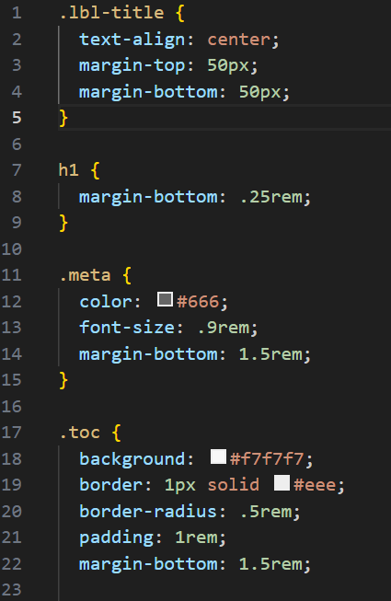
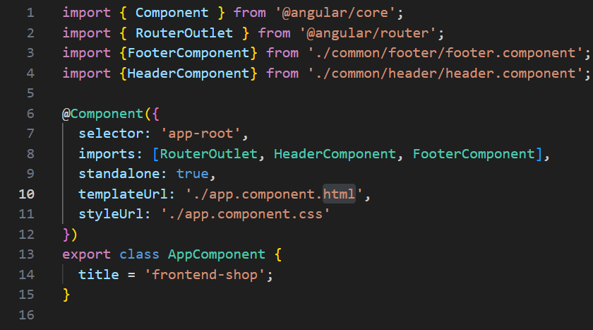
Front end: Angular Single Component example CSS, HTML, Typescript, Service

Slide 10
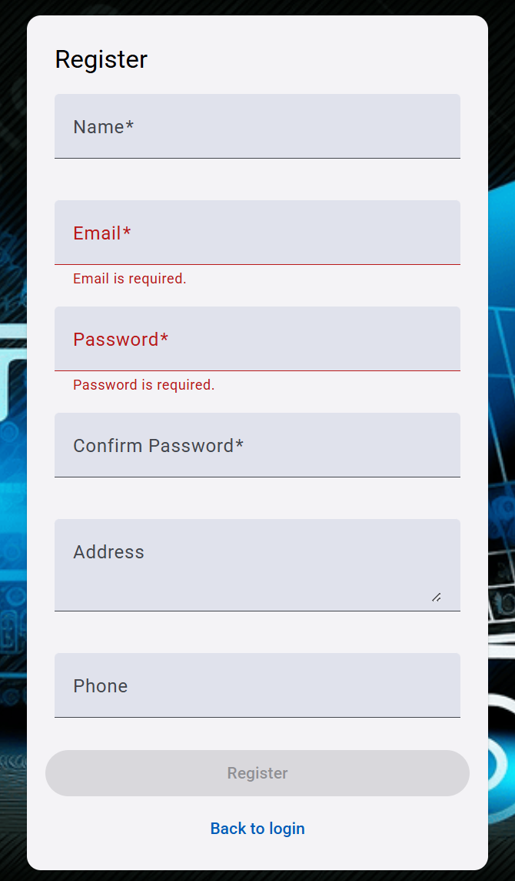
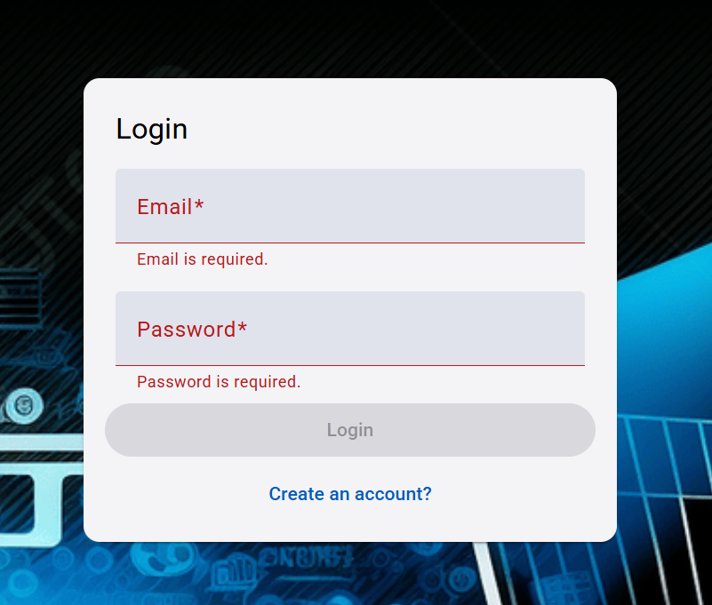
User Interface: Auth page – Login form Auth page – Register form

Slide 11
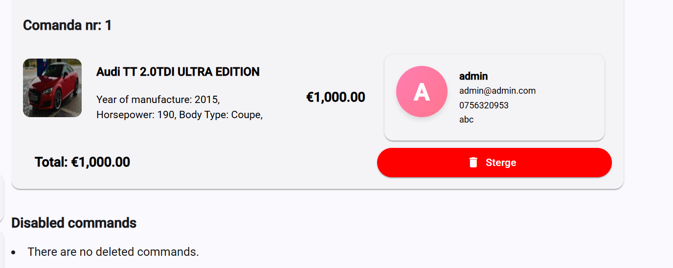
User Interface: Commands – user can view, edit and add commands

Slide 12
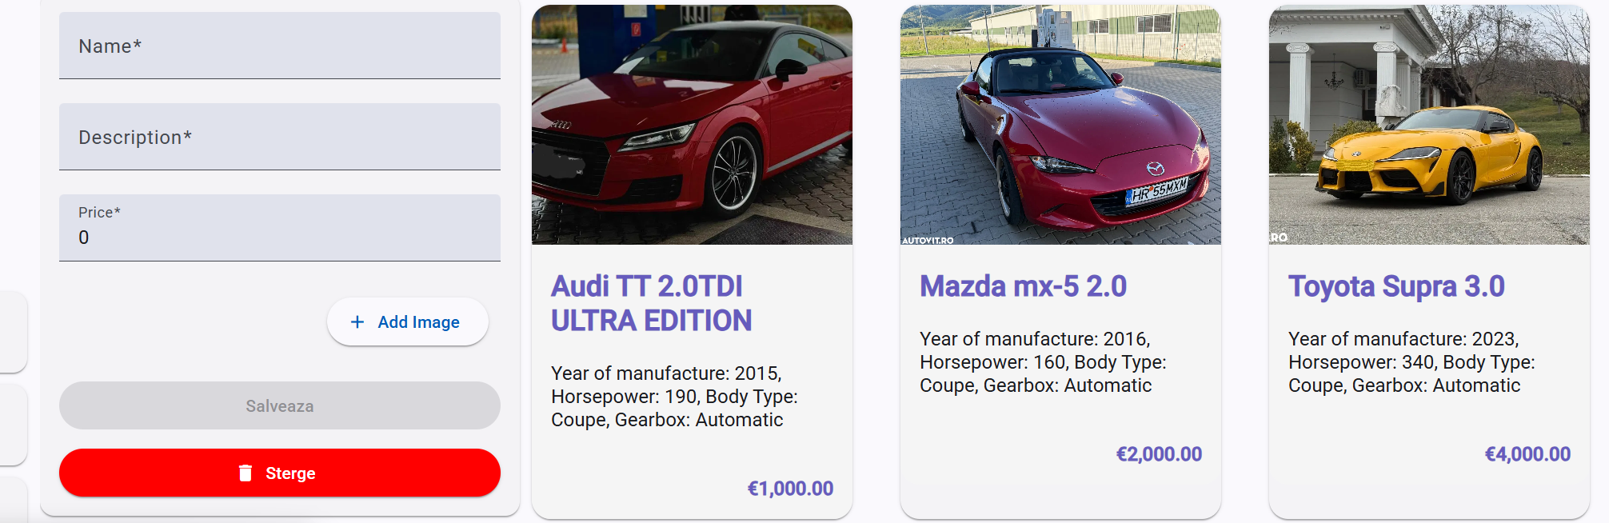
User Interface: Products – user can view, edit, add, delete authors

Slide 13
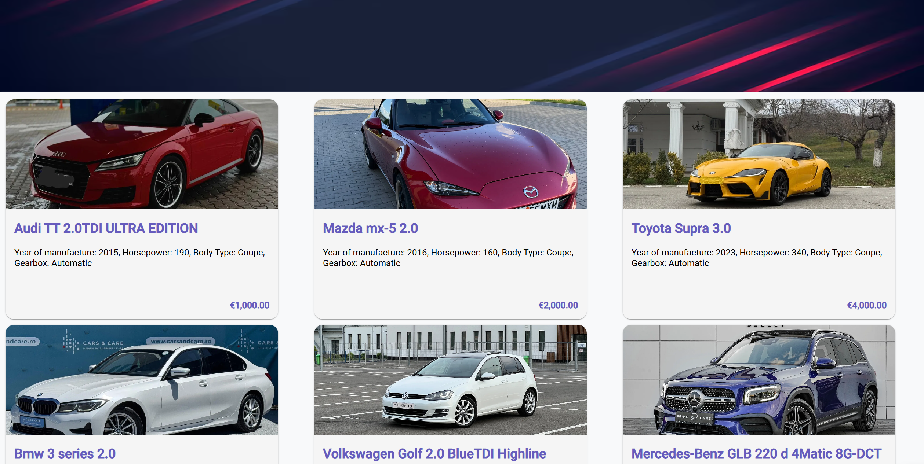
User Interface: Home – user can view, edit, add, delete cars

Slide 14
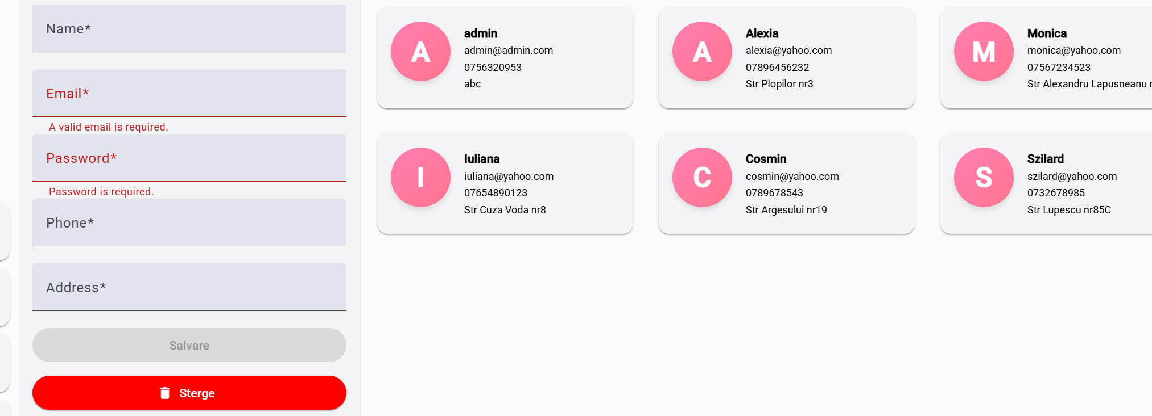
User Interface: Users – user can view, edit, add, delete clients

Slide 15
Features and upgrades
Support from administrators:
• Email submission form
• Chat system
• FAQ page
Login and registration:
• Support third party login with OAuth2
• Facebook
• Google
• Twitter
Reporting opportunity:
• Export information available to Excel, PDF
• Arrange information into charts

